Slide 1

UNITED STATES SALES CORPORATION
1894
2010
UNITED STATES SALES
CORPORATION

Slide 2
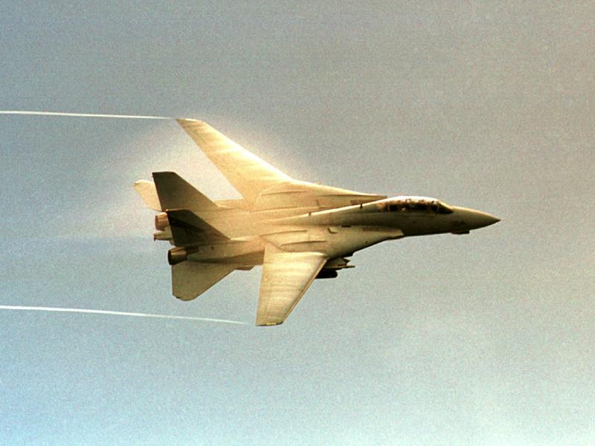
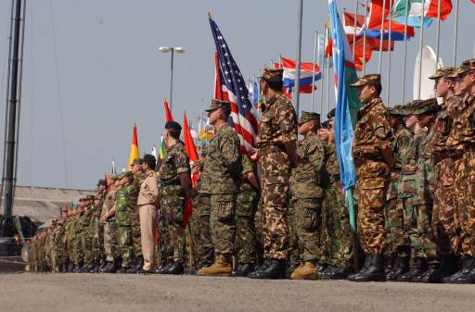
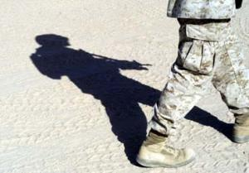
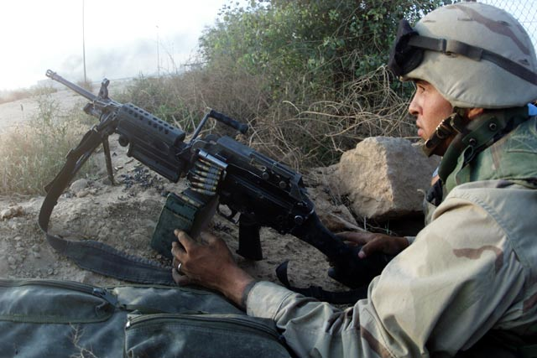
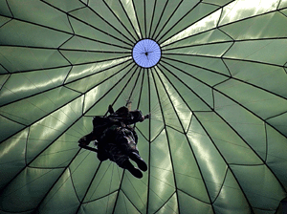
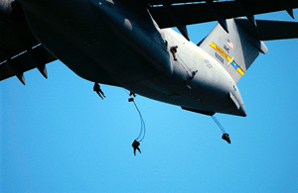
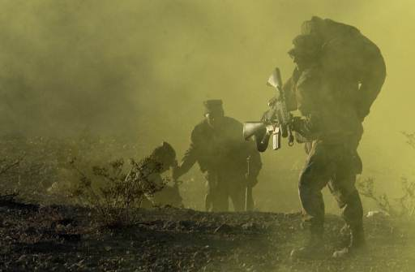
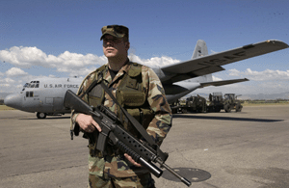
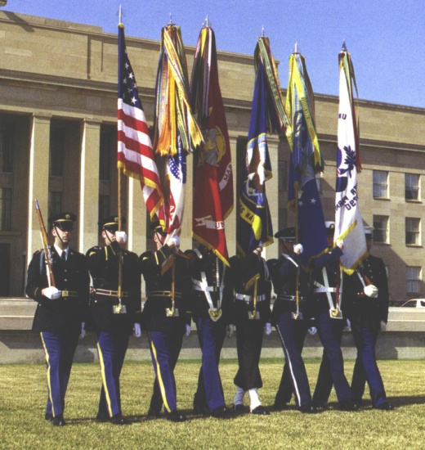
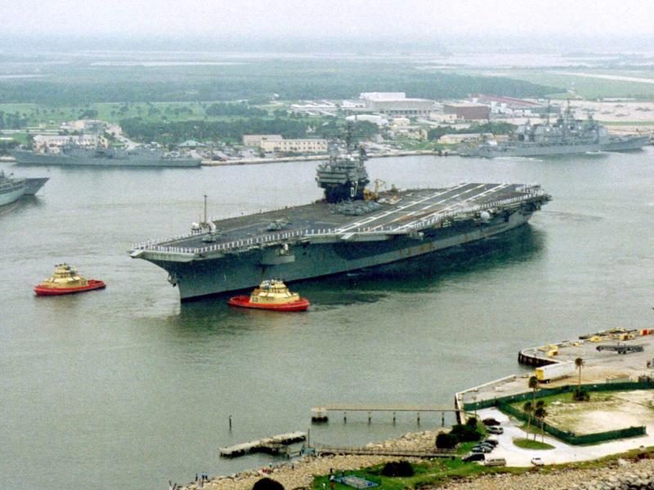

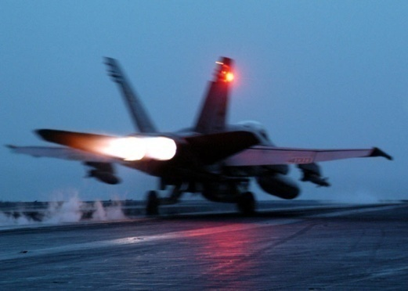
United States Sales Corporation Military Exchange Market Specialists

Slide 3
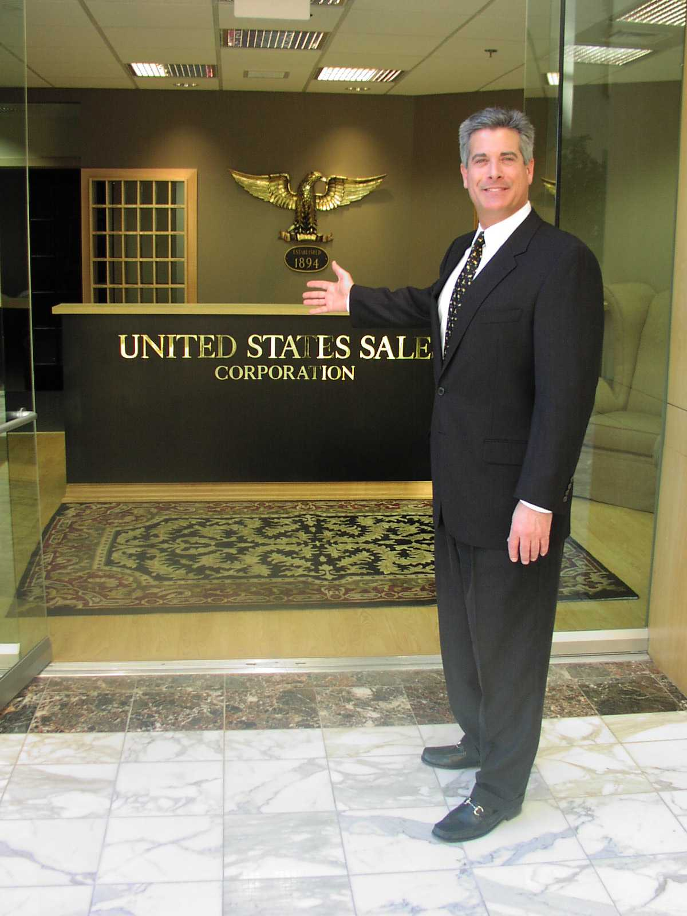
Welcome to United States Sales Corporation
Louis P. Snyder
President

Slide 4
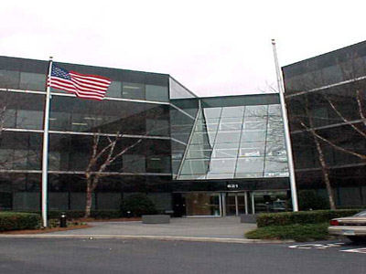
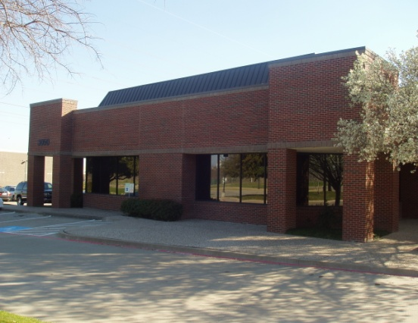

United States Sales Corporation is a Leading Manufacturers’ Representative Agency in the Military Exchange Market with a 116 Year History of Successful “Resale” Experience
Virginia Beach, VA Corporate Headquarters
Dallas, TX
Corporate Headquarters
Established 1894

Slide 5

USSC Company Values
INTEGRITY: We always tell the truth and we always do what we say we will do. Our word is our bond.
RESPECT: We treat every team member, customer, supplier and even competitor, with kindness and respect.
CONSTANT IMPROVEMENT: We are proud of what we have accomplished, but we are never satisfied. We relentlessly evaluate how we can improve our brand sales, our service to our manufacturers and customers, our internal systems, and ourselves. We constantly improve our organization in each of these areas.
PASSIONATE / DEDICATED: We are committed to fulfilling the mission of our industry...to provide our customers with nationally recognized brands at the lowest possible costs. We are relentless in infusing our passion and dedication to our manufacturers with the sincere hope they will also demonstrate the same level of keenness to maximize their opportunities within this special market place.
INITIATIVE / CREATIVE: We will grow our business from the creativity of each of our team members. We value and challenge their open-mindedness and sales leadership qualities. Initiative creates opportunities and growth.
CUSTOMER SUCCESS: Our primary value is the success of our customers, even if it might not be the best solution for us. We strive to be their best and most wanted sales representative agency. We give them the best service we can give wherever our customers serve their country.
Continued on Next Slide …

Slide 6
USSC Company Values
Continued from Previous Slide …
COMMERCIAL: All team members’ most important focus is the improvement of our sales performance for the vendors whom we are so proud to represent.
TEAM PLAYER: We are all servants to the team's vision and goals. No person is more important to the team when we do what is necessary to help the team win. We will win! There is no 'I' in the word team!
POSITIVE: Every team member must infuse our team with positive energy; we do not tolerate anyone who drains our energy.
STRETCH / GROW: We pull team members up, and we push team members up. We show the flexibility when we are ourselves challenged, to make sure we stick together, stay the course, and create personal growth for each of us.
PRIDE: We take to heart that our organization serves the best customers in the world. We are indeed proud of the customers we serve, and we are proud of 'our' military service.
FUN: We love what we do and the impact we have on the success of our brands, our customers, and our industry! We enjoy each step of our remarkable journey.

Slide 7
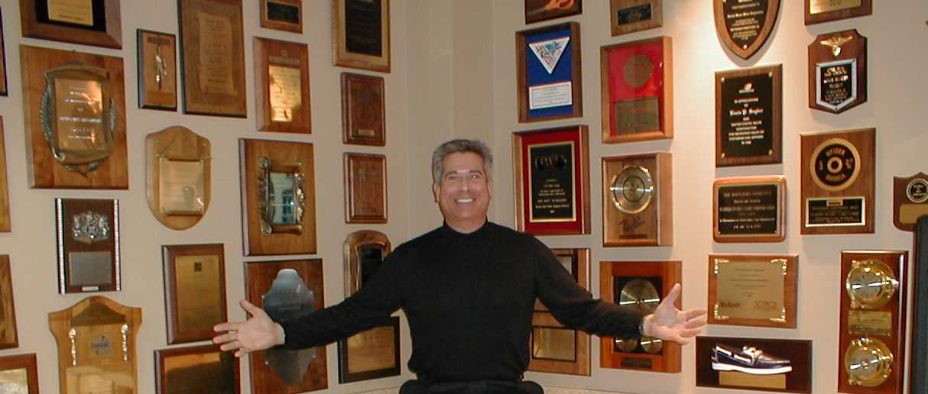
United States Sales Corporation’s Proven Sales Successes

Slide 8





United States Sales Corporation Will Optimize Your Sales Potential in the Military Exchange Market

Slide 9
Retail Spending U. S. Retail Economy (2008)
USSC – Sales History
2008 – Record Year for Sales Growth!
(+16%)

Slide 10
Military
Exchange
Demographics

Slide 11
Total Exchange Sales
Direct Sales, FY 2008, In Millions
Total $12,292.0 Difference (FY07) +2.8%
Source: Exchange & Commissary New – 10/09

Slide 12
Exchange Sales FY 1996 - 2008
Direct Sales in $ Millions
Source: Exchange & Commissary New – 10/09

Slide 13
2008 Rank | 2007 Rank | Retailer | 2008 Sales in Billions 10/0 | Change from 2007
1 | 1 | Wal-Mart Stores | $405.607 | +7.1%
2 | 3 | CVS Caremark | 87.472 | +14.6
3 | 4 | Costco | 72.483 | +12.6
4 | 2 | Home Depot | 71.288 | -15.9
5 | 5 | Target | 64.948 | +2.5
6 | 6 | Walgreen | 59.034 | +13.4
7 | 8 | Lowe’s Companies | 48.230 | -0.1
8 | 7 | Sears Holdings | 46.770 | -7.8
9 | 9 | Best Buy | 40.023 | +11.4
10 | 10 | Macy’s | 24.892 | -5.5
11 | 14 | Rite Aid | 24.417 | +39.5
12 | 12 | Staples | 23.083 | +19.2
13 | 18 | Amazon.com | 19.166 | +29.2
14 | 13 | TJX Companies | 19.148 | +2.7
15 | 11 | J. C. Penney | 18.486 | -6.9
16 | 15 | Kohl’s | 16.389 | -0.5
17 | 16 | Gap | 14.526 | -7.9
18 | 17 | Office Depot | 14.496 | -6.6
19 | 19 | U. S. Military Exchanges | 14.153 | +3.2
20 | 20 | Toys “R” Us | 13.724 | -0.5
21 | 21 | Circuit City Stores | 11.744 | -5.5
22 | 23 | Dollar General | 10.458 | +10.1
23 | 25 | BJ’s Wholesale Club | 10.027 | +11.4
24 | 22 | Limited Brands | 9.043 | -10.8
25 | - | Nordstrom | 8.573 | -5.6
America’s Top
Retailers
General/Specialty Merchandise
2008 Rank/2007 Rank/
Retailer/2008 Sales
In Billions*/% Change from 2007
“Top retailers” sales figures include concession
and other indirect income
Source: Exchange & Commissary News 10/2009

Slide 14
Exchange Stores
As of September 2009
Conus – 442 Overseas – 95 Worldwide - 537
Source: Exchange & Commissary News 10/09

Slide 15
10,440,353 Authorized Military Exchange Shoppers*
*Total does not include the estimated 600,000 DoD Civilians, their dependents and eligible international military members who are authorized users of portions of the military resale system
** Retirees - Includes Regular & Reserve Retirees and their dependents
Source: AAFES, DMDC Masterfile, (September, 2007) Military Retailer 2010 Fact Book

Slide 16
Age of Active-
Duty Military
Age of the Selected Reserve
Selected Reserve members tend to be older than their active duty counterparts: Almost 1/3 (30.8%) are 25 or younger, versus the nearly half (47.5%) of active duty members in the same age bracket.
Nearly 8 of 10 (79.8%) active duty military members are under age 35.
Source: DMDC Active Duty Master File (September 2007) –
Military Retailer, 2010 Fact Book
Source: DMDC Reserve Components Common
Personnel Data System (September 2005) –
Military Retailer, 2008 Fact Book

Slide 17
Age of Dependents – Active Duty
Age of Dependents – Selected Reserve
Source: DMDC Miltary Family File (September 2007) –
Military Retailer, 2010 Fact Book

Slide 18
Active Duty Military Market
Active Duty by Race/Ethnicity
Active Duty by
Component
Source: DMDC Reserve Components Personnel Data System (September 2007) – Military Retailer, 2010 Fact Book
Source: DMDC Active Duty Master File
(Sept. 2007) – Military Retailer, 2010 Fact Book

Slide 19
Military
Exchange
Locations

Slide 20
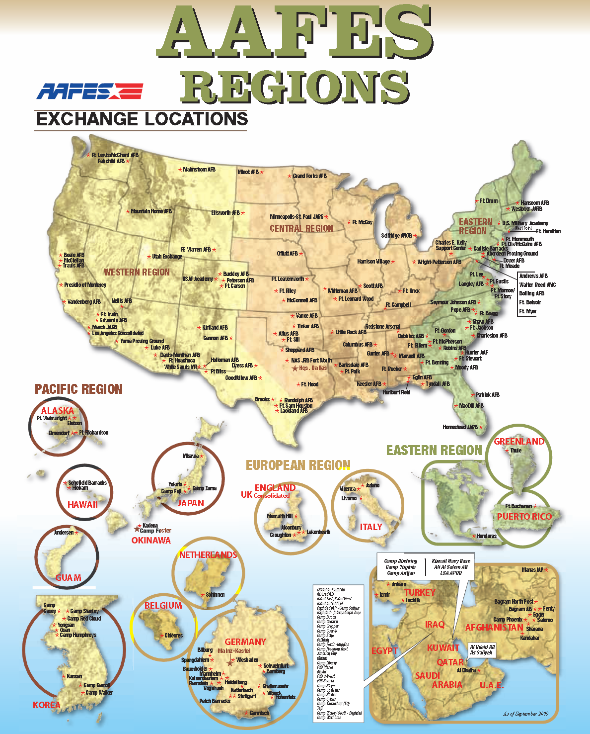


Slide 21
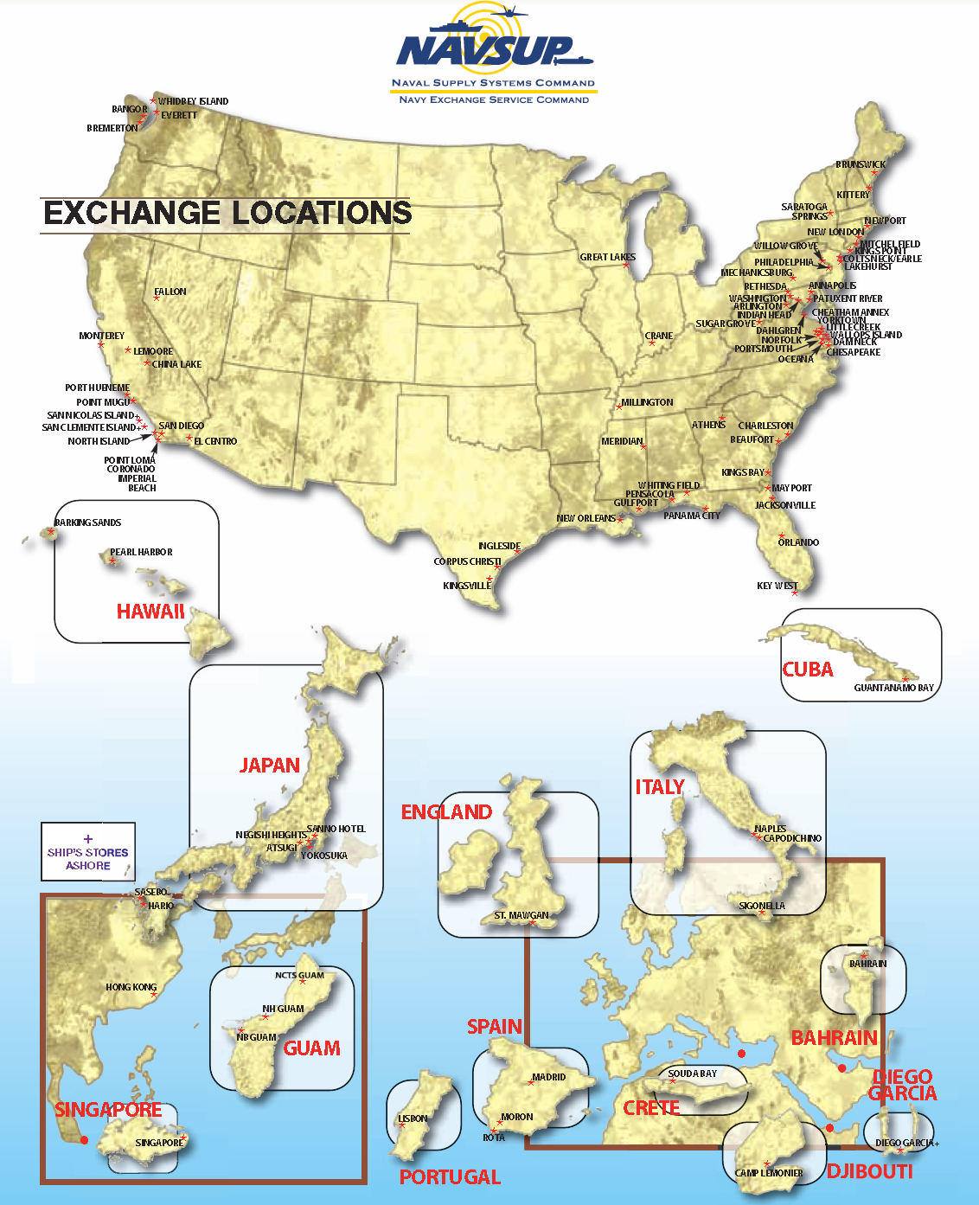

Slide 22

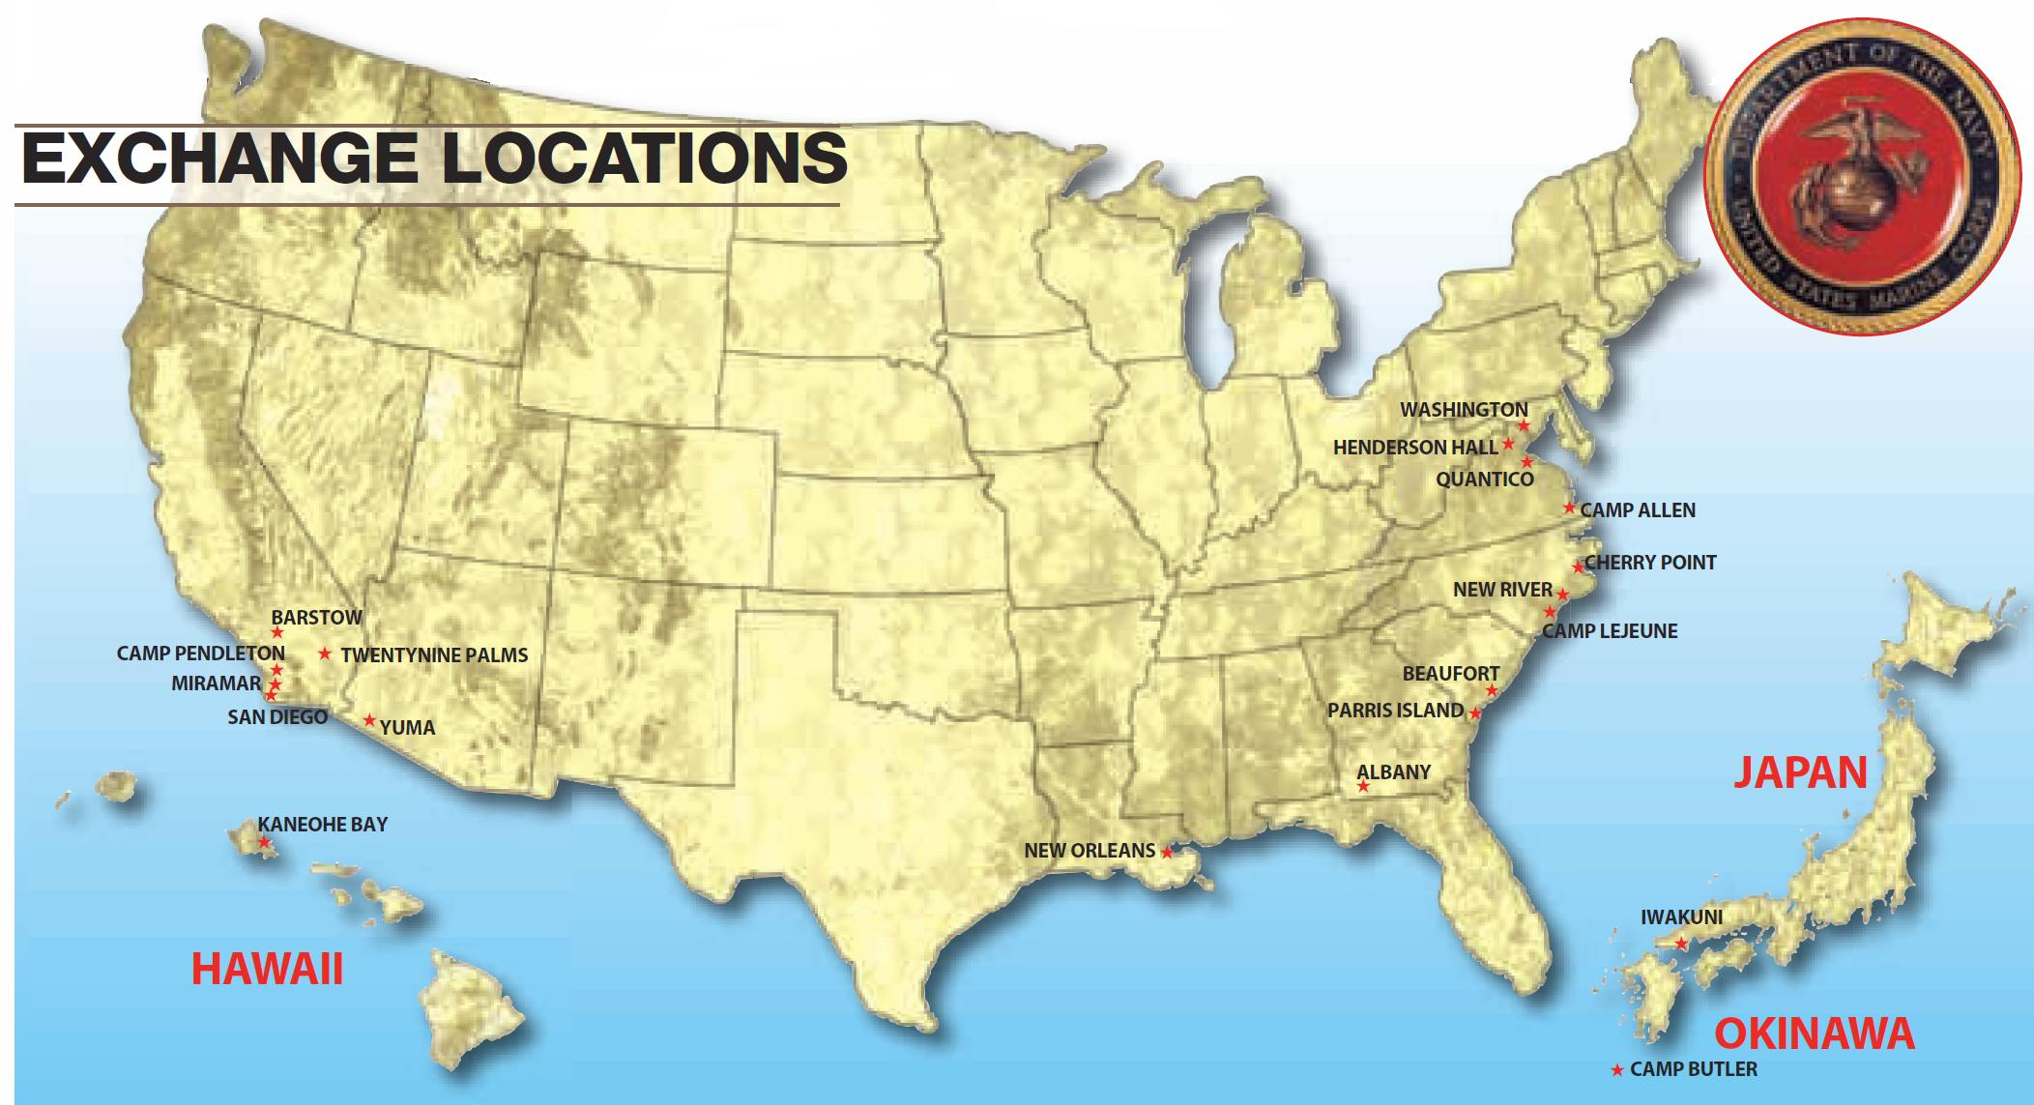

Slide 23

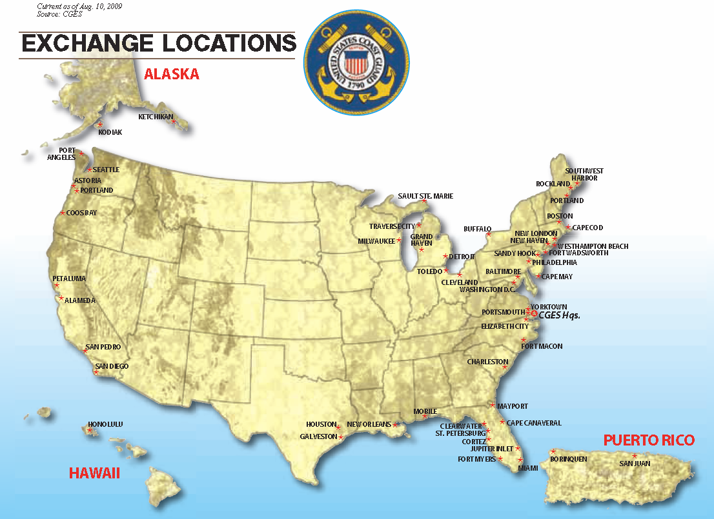

Slide 24
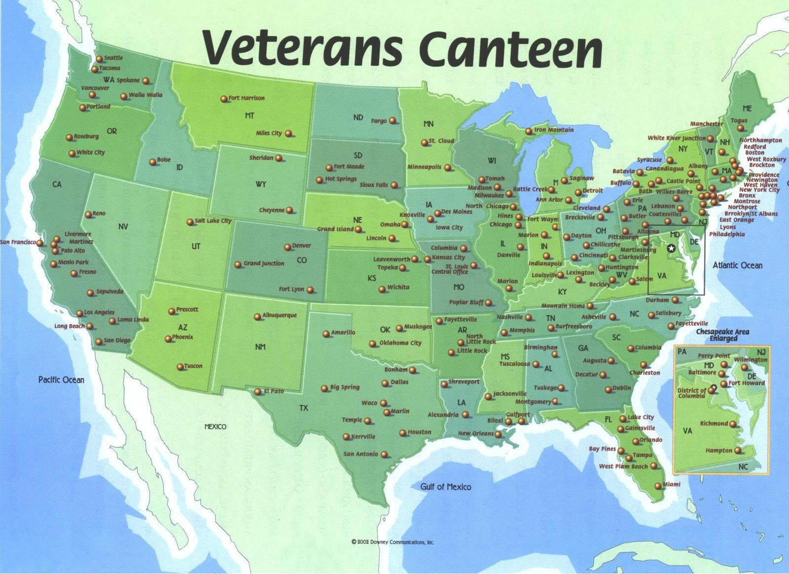

Slide 25
U. S. Sales
Corporation’s
Manufacturers’
Portfolios

Slide 26










CONSUMER ELECTRONICS PORTFOLIO
Dedicated Account Executives:
AAFES/NAVY/MC/CG: Mr. Nick Cohen • (757) 340-4000 X331 [ncohen@ussalescorp.com]
VCS: Ms. Darlene Davies • (757) 428-8244 [DDaviesUSSC@aol.com]

Slide 27












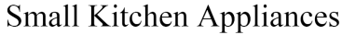












HOUSEWARES PORTFOLIO
Clock Division
.
Dedicated Account Executives:
AAFES/Navy/MC/CG: Mr. Russell Jones • (972) 247-0900 [rjones@ussalestexas.com]
VCS: Ms. Darlene Davies • (757) 428-8244 [DDaviesUSSC@aol.com]

Slide 28








HOME FURNISHINGS PORTFOLIO
Dedicated Account Executives:
AAFES/NAVY/MC/CG: Ms. Debbie Patterson • (972) 247-0900 [dpatterson@ussalestexas.com]
NAVY/MC/CG: Ms. Heather Snowa • (757) 340-4000 [hsnowa@ussalescorp.com]
VCS: Ms. Darlene Davies • (757) 428-8244 [DDaviesUSSC@aol.com]

Slide 29







FOOTWEAR/SOFTLINES PORTFOLIO
Dedicated Account Executives:
AAFES/NAVY/CG/MC/VCS: Mr. Ray Dixon • (757) 340-4000 [rdixon@ussalescorp.com]
AAFES (Asics): Mr. Justin Webster • (214) 691-5419 [justin.webster@charter.net]

Slide 30





SPORTING GOODS PORTFOLIO
Head / Penn Racquet Sports
Dedicated Account Executives:
AAFES/NAVY/MC/CG: Mr. Nick Cohen • (757) 340-4000 [ncohen@ussalescorp.com]
VCS: Ms. Darlene Davies • (757) 428-8244 [DDaviesUSSC@aol.com]
NAVY/MC/CG (Jansport Only): Ms. Olympia Frink • (757) 340-4000 [ofrink@ussalescorp.com]

Slide 31











CANDY, CONFECTIONARY & GOURMET FOODS PORTFOLIO
Dedicated Account Executives:
AAFES: Ms. Debbie Patterson • (972) 247-0900 [dpatterson@ussalestexas.com]
NAVY/MC/CG: Ms. Leslie Gilchrest • (703) 266-6704 [ljvt@aol.com]
VCS: Ms. Darlene Davies • (757) 428-8244 [DDaviesUSSC@aol.com]

Slide 32





TOYS PORTFOLIO
Dedicated Account Executives:
AAFES/NAVY/MC/CG: Ms. Olympia Frink • (757) 340-4000 [ofrink@ussalescorp.com]
AAFES/NAVY/MC/CG: Ms. Heather Snowa • (757) 340-4000 [hsnowa@ussalescorp.com]
VCS: Ms. Darlene Davies • (757) 428-8244 [DDaviesUSSC@aol.com]

Slide 33
118 U.S.S.C. Field Sales And Service Representatives Within 16 Countries Worldwide
● USA
- (CONUS) 48 STATES
- ALASKA
- HAWAII
● PUERTO RICO
● BAHRAIN
● CUBA
● GREECE
● UNITED KINGDOM
● SPAIN
● ITALY
● NETHERLANDS
● GERMANY
● TURKEY
● SAUDI ARABIA
● DJIBOUTI
● KOREA
● JAPAN
● GUAM

Slide 34
United States Sales Corporation Organization Chart
Dallas
Headquarters Office
Louis P. Snyder
President/C.E.O.
Virginia Beach
Headquarters Office
Heather Snowa
Vice President/
General Manager
Donna Martinez
Vice President-
Finance / Comptroller
Joan McCorkle
Vice President
AAFES Sales Administration
Virginia Beach AAFES Liaison
Nathaniel J.
“Nick” Cohen
Vice President - Marketing
Darlene K.
Davies
Vice President -
VCS Operations
Ray Dixon
Senior Account
Executive
AAFES/NEXCOM/MC
CGX/VCS Headquarters
Christy Sellers
Accounting Assistant
Russell Jones
Account Executive/
Office Manager.
(Dallas Hdqtrs.
Office)
Debbie Patterson
Account Executive
(Dallas Hdqtrs.
Office)
Justin Webster
Account Executive
Athletic Footwear
(Dallas Hdqtrs Office)
Leslie Gilchrest
Account Executive
NEXCOM/MCX/
CGX Headquarters
Daniel Hollinger
Account Executive
AAFES/NEXCOM/MCX/
CGX Headquarters
Olympia Frink
Account Executive
AAFES/NEXCOM/MCX/
CGX Headquarters
Lynett McCoy
Admin. Assistant
(Dallas Hdqtrs.Office)
Marilyn Monnette
Admin. Assistant
(Dallas Hdqtrs.Office)
Cathy White
Exchange
Sales Manager
Jackie
Radabaugh
Assistant Account
Executive - Furniture
Graphic Arts/
Sample Distribution
Point-of-Purchase
Department
Jackie Goard
Assistant Vice President
of Publications /MIS/IT
Della Ipock
Assistant Account
Executive - Footwear /
Footwear Customer
Service Rep –
NEXCOM/MCX/CG
Sample/P.O.P. Coordinator
Nancy Ince
Admin. Assistant
(Dallas Hdqtrs.Office)
Vanessa Rubio
Admin. Assistant
(Dallas Hdqtrs.Office)
George Scott
Western Zone Mgr./Trainer
Michael Chapdelaine
Eastern Zone Mgr./Trainer
FIELD SALES FORCE*
Customer Service Representatives/Admin. Asst.
Tonia Robinson (Asst. to Nick Cohen)
Nicole Anderson (Asst. to Heather Snowa & Leslie Gilchrest)
Kirstie DeBeau (Asst. to Olympia Frink & Darlene Davies)
Mackenzie Snyder (Assistant to Ray Dixon & Della Ipock)
Regional Managers*
Retail Specialists*
* See Sales Representatives Listing
Revised January 2010

Slide 35
U. S. Sales Corporation Provides Our Manufacturers & Exchanges
Regular In-Store Service (Every 1 – 4 Weeks)
Service Sponsored Training Seminars & In-Store Group/Individual Product Training
In-Store Merchandising / POG Implementation & Maintenance
In-Store Servicing of All Direct Store & Warehouse (D.C.) Supported Programs
Management Audits for Warehouse & Direct Store Delivery Programs
On-Floor Product Demonstration Support & Direct Consumer Sales
Hands On Servicing
Validation of All Return Authorization Requests

Slide 36
U. S. Sales Corporation Provides Administrative Support
Order Verification / Processing
Vs. Established Sales Plan
Database Order
& Shipment
Tracking
Management
of Co-Op
Funding & Accruals
Provide Accounts
Receivable
Assistance
Management of
Demonstration
Funding Allowances
On-Line Order Entry
(If Applicable)

Slide 37
U. S. Sales Corporation Provides Our Manufacturers & Buyers
Recommendations for
Basic Stock Assortments
Recommendations for
Corporate Promotions
Merchandising Programs /
P.O.G. Placement
Concept Shop Campaigning
& Development
Management & Reporting
Of Inventories
Local Promotions with USSC
P.O.S. Bulletins
(In-House Publication Dept.)
In-Store “Selling” of
Headquarters Programs
Monthly or Quarterly Product
Sell-Through Analysis

Slide 38
U. S. Sales Is Committed To Provide Our Manufacturers…
Excellence in
Service and Support!
Experienced, Product Specific Account Executives
Well Trained Field Management (Regional Managers)
Effective
In-Store Service Personnel
Dedicated Service Branch & Category Administrative Assistants
Monthly Volume/
Status
Reports
Incoming Order Activity Reports

Slide 39
Partnership Commitment
Worldwide Representation
Dedicated and Accessible Points of Contact
Timely Product Information Updates
In Store Point of Sale Materials
Promotional Support
Attractive Margins for Military for Competitive Product Maintenance

Slide 40
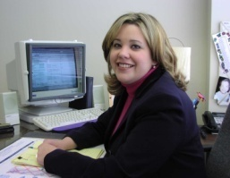
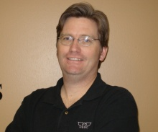
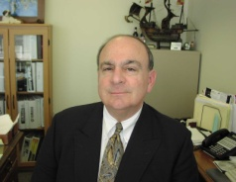
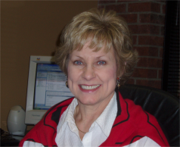
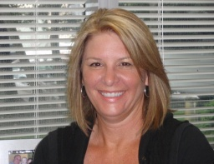
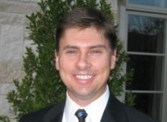
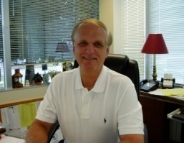
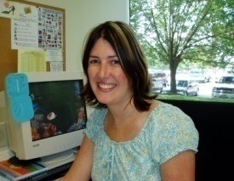
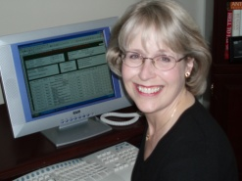
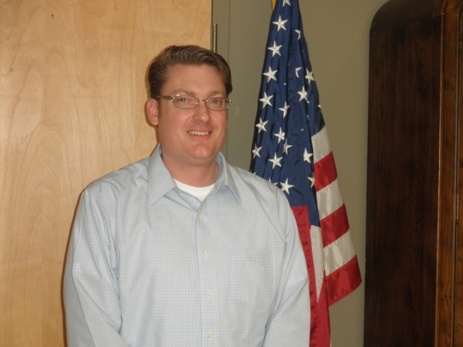
Account Executives Are Committed To:
Heather Snowa
Vice President/
General Mgr.
Virginia Beach
Establish Programs / Parameters with Manufacturer Representative(s)
Prepare and Administer All Promotional and Basic Stock Assortment Submissions and Follow-Through
Manage Cooperative Advertising, Market Development, and Demonstration Funds
Coordinate and Align Special Events with Exchange Management and Corresponding Field Sales Representatives
Manage Product Projections for All Basic Stock Assortments and Promotional Buys by SKU, Via a 6 Month Rolling Forecast
Russell Jones
Account Executive - Dallas
Nick Cohen
V.P. – Marketing
Virginia Beach
Debbie Patterson
Account Executive - Dallas
Justin Webster
Account Executive -
Athletic Footwear –
Dallas
Darlene Davies
V.P. – VCS Operations
Virginia Beach
Ray Dixon
Senior Account Executive
Virginia Beach & Dallas
Olympia Frink
Account Executive
Virginia Beach & Dallas
Leslie Gilchrest
Account Executive
Virginia Beach
Daniel Hollinger
Account Executive
Virginia Beach

Slide 41
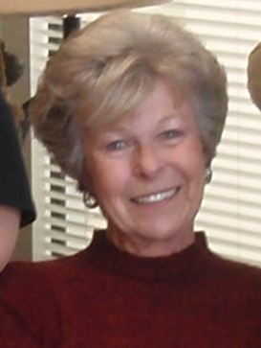
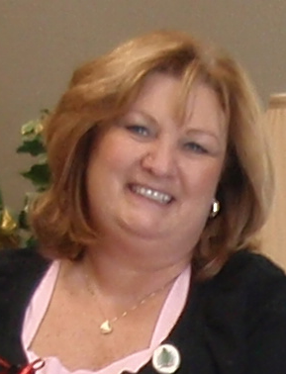
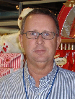
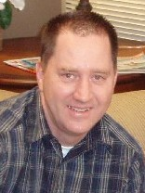
USSC Sales Management Team
Joan McCorkle
V.P. – AAFES Sales Administration
Virginia Beach & Dallas
Cathy White
Exchange Sales Mgr./Director of Field Personnel
Virginia Beach
George Scott
Western Zone Manager / Trainer
San Diego, CA
Mike Chapdelaine
Eastern Zone Manager / Trainer
Virginia Beach, VA

Slide 42
USSC
Account
Executive/Sales
Management
Tools…

Slide 43
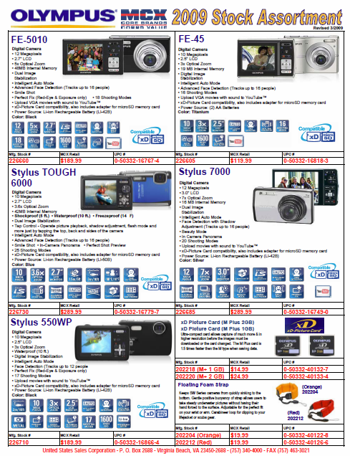
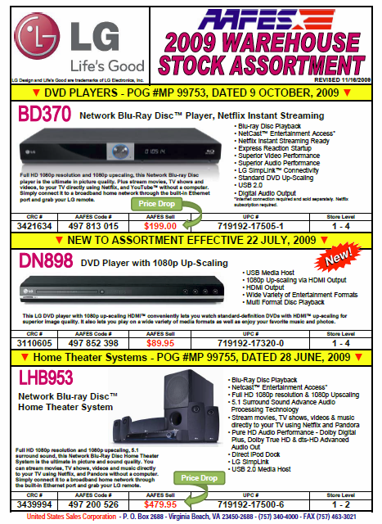
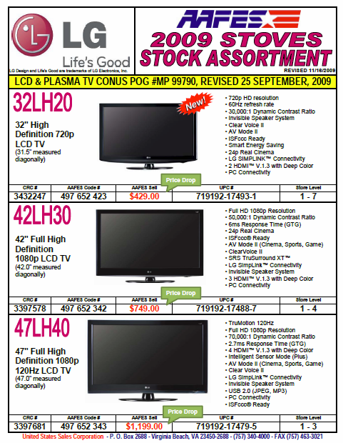
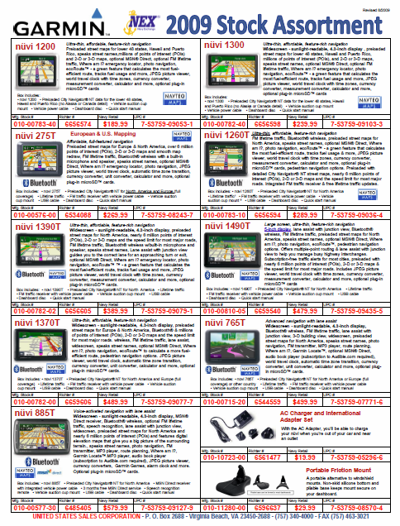
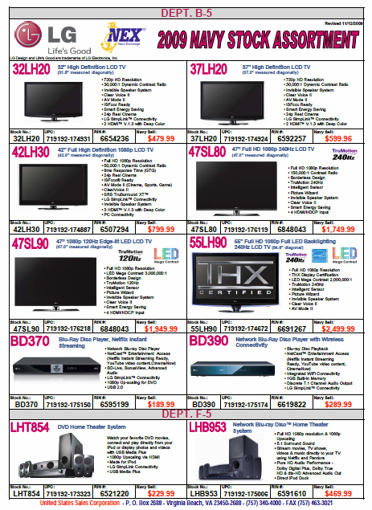
USSC Produces Current Stock Assortment Color Sheets for Each Branch of Service
SAMPLES

Slide 44
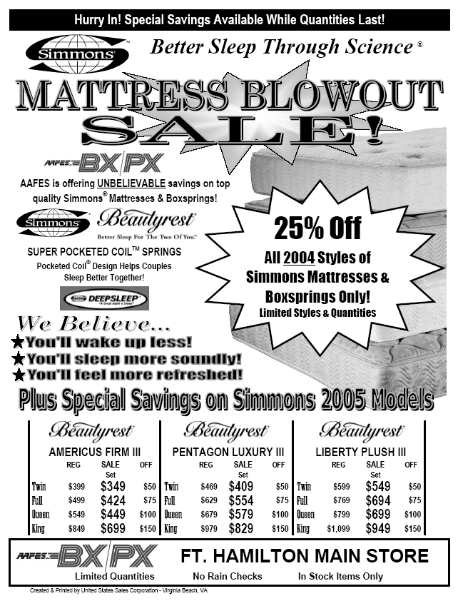
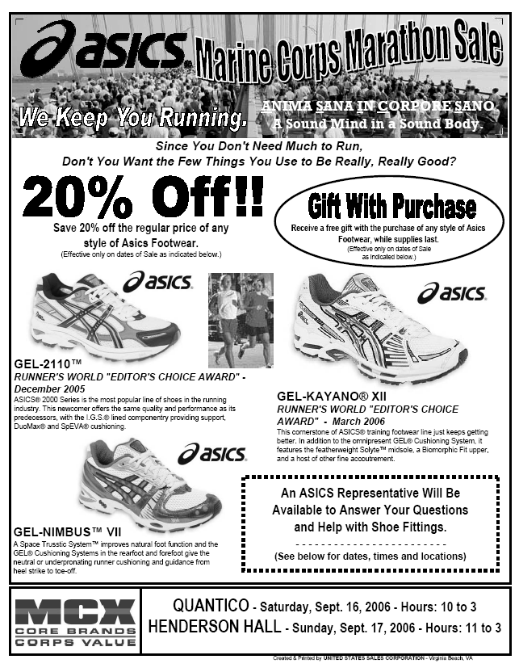
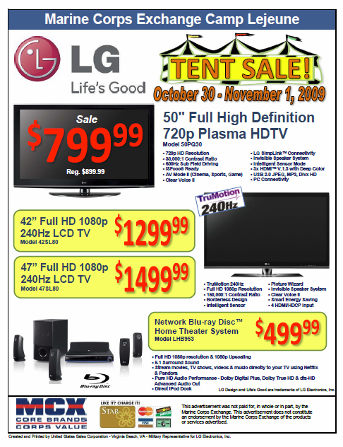


USSC Product Support
USSC Produces Black & White Handout Sale Flyers & Color Sale Easels/Posters for Select Advertised Sale Events
Samples

Slide 45
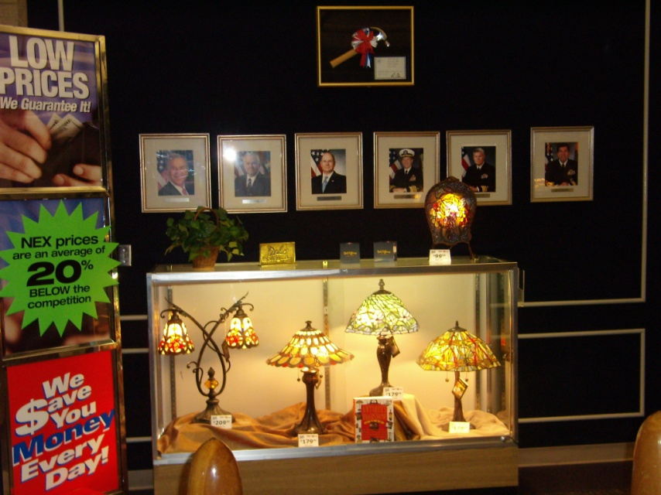
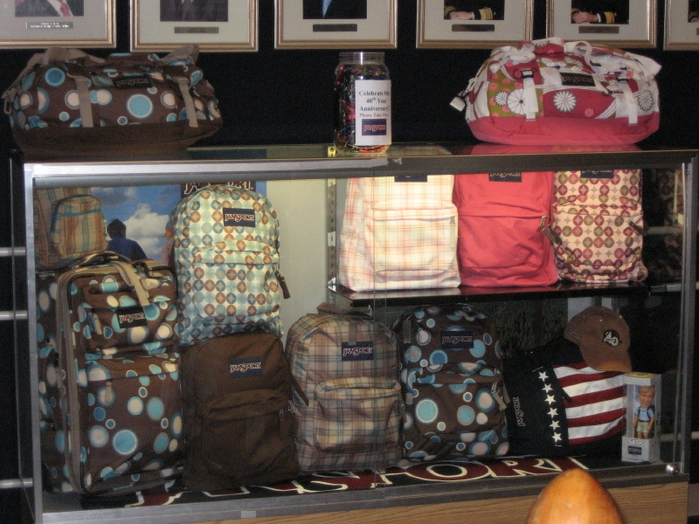
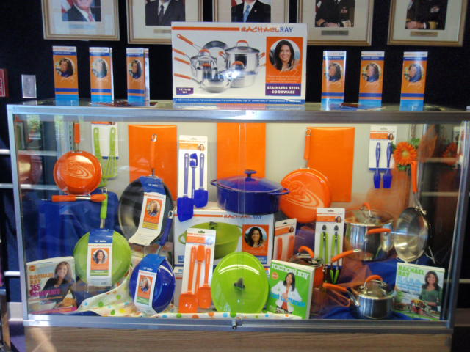
Featured Brand Display in NEXCOM Lobby
Located in Virginia Beach, VA
USSC participates in promoting its portfolio of brands to NEXCOM Headquarters personnel
Featured Brand: Dale Tiffany Lamps
Featured Brand: Jansport Backpacks
Featured Brand: Rachael Ray Cookware

Slide 46
USSC Customer Service
“Servicing the Best Customers in the World”
Customer Service is not a department, it is an attitude!
USSC Customer Service personnel directly input military exchange P.O.s for a number of our assigned manufacturers via their extranet/intranet order systems
Examples:
Kenwood Electronics
Asics America
Bushnell
K’nex

Slide 47
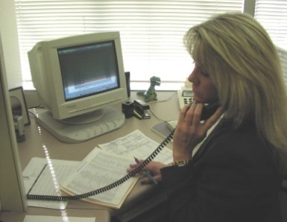
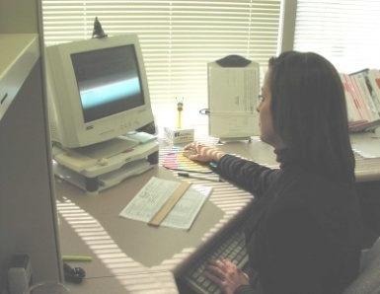
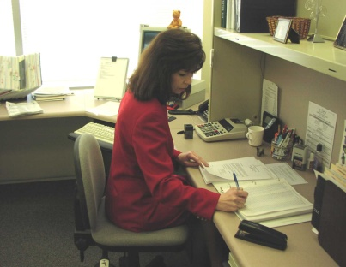
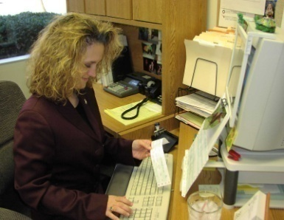

Administrative Assistants
Are Committed to:
Order Processing and Verification
Process Return Authorization Requests
Product Availability Maintenance
Process Chargebacks
Provide Accounts Receivable Assistance
Coordinate and Communicate Ship Status & Proof of Delivery Requests
Manage Instant Rebates
Manage Co-op Advertising Claims

Slide 48
Field Sales Representatives Are Committed To:
Provide Regularly Scheduled Exchange Visits
Provide Merchandising Support & Photo Updates
Ensure Placement of P.O.P. Materials
Perform Field Audits Reporting Inventory, Sell Thru & Plan-O-Gram Compliance Information
Provide Ongoing Sales Associate Product Training
Manage Inventories and Secure Approval for Any Authorized Direct Store Delivery Opportunities
Provide Product Sales and Consumer Demo Support

Slide 49
Product Training/Sales Seminars
(Sponsored by AAFES, Navy and MCX Headquarters)
Sales Seminars for Exchange Staff Include:
Manufacturer’s History
Brand Positioning and Strategy Information
Product Offering, Features & Benefits
Training on Selling Techniques
Training on Promotional Programs

Slide 50


AAFES
Electronics
Expo
Dallas, TX
July, 2009

Slide 51

Navy Electronics Expo
Chesapeake, VA
August, 2009

Slide 52


MCX
Electronics
Expo
San Diego, CA
April, 2009

Slide 53





Marketing Resources Our in-store sales and service support includes Merchandising, Training, Replenishment and Demonstrations (MTRD). The Military Exchange Market is dependent upon its retail partners to provide a significant commitment to store level hours in support of the sell-thru of each brand, as well as to ensure our manufacturers are represented at "Show-and-Sell" events, all Headquarters sponsored/in-store product training events, New Store openings, and in maximizing all other Special Sale Event opportunities.
Recreation
Event Support
Grand Opening Support
Volume Sales Events/Tent Sales
Store Level Demos
POP Support

Slide 54







Recent Event
Grand Opening of Coast Guard Exchange,
Chesapeake, VA
October 30, 2009

Slide 55
United States Sales Corporation Provides Continual Merchandising Support Services

Slide 56






Ft. Myer
Ft. Sill
Andrews AFB
Ft. Bragg

Slide 57









Jacksonville
Oceana
Pearl Harbor
Norfolk

Slide 58











Quantico
MCRD
Henderson
Hall
Camp Lejeune
Miramar

Slide 59





USSC Provides Headquarters’ Plan-o-gram (POG) Conformity Support

Slide 60





United States Sales Corporation Provides In-Store Sales Associate Product Training

Slide 61






United States Sales Corporation Provides In-Store Product Demonstrations

Slide 62











USSC / LG “Techknowledgey” Seminar April 2009 Virginia Beach, VA

Slide 63




United States Sales Corporation’s Offices Provides Facilities for Manufacturer’s Presentations to Exchange Buyers

Slide 64

United States Sales Corporation Provides Continual In Store Analysis For Management Of Warehouse and All Direct Store Delivery Programs

Slide 65

United States Sales Corporation Participates During All VCS Show & Sell Events

Slide 66
Contact Information
Virginia Beach Corporate Headquarters:
621 Lynnhaven Parkway, Suite 100
Virginia Beach, VA 23452
(757) 340-4000 – FAX (757) 463-3021
Dallas Corporate Headquarters:
3050 Regent Boulevard, Suite 150
Irving, TX 75063
(972) 247-0900 – FAX (972) 247-9961
Visit Us at www.ussalescorp.com

